Slide 1
Clearing your CodeX

Slide 2
The need for clearing code
Every time you run your program, it is loaded onto the CodeX
The last program run stays on the CodeX, even after it is unplugged from the computer
So you want the last program run to be something that clears the CodeX and isn’t an assignment

Slide 3
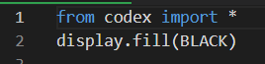
Create a file “Clear”
Create a new file called Clear
Type these two lines of code:
Run the code
The CodeX should be blank, with no pictures or lights on
Run this code at the end of every class period

